Slide 1
Lubrication: Slip N Slide!
Colin Farquhar, PE (ST/4th)

Slide 2
Why lubricate?
Anytime we have two objects moving against each other, a portion of the kinetic energy (movement) will be turned into heat-wasted energy!
A substance's resistance to movement when in contact with another substance can be expressed as it's Coefficient of Friction
Excessive friction and heat will result in damage

Slide 3
Rules of Lubrication
If there is a moving part, it needs lubrication (Rotating shafts, sliding parts, etc)
Use lubricants that are the correct type for the application (temperature, pressure, environment)
Use clean lubricants-store them safely.

Slide 4
Types of Lubricants
Three main areas with regards to Steam Traction Engines
1) Steam Cylinder Oil
2) Journal/Bearing Oil
3) Grease

Slide 5
Steam Cylinder Oil
It's the ultimate 20 Questions answer!
Animal, Vegetable and Mineral (at some points!)
It is a compounded oil, currently produced with a majority of petroleum base stock and animal tallow added to emulsify the oil in the steam.
Introduced directly into the steam line feeding the engine, carried along to lubricate valve chest, valve, piston and all internal surfaces

Slide 6
Steam Cylinder Oil
Steam oil is blended in various grades for different pressure and temperature ranges
Different blends available for Saturated or Superheat service
Can be used in large babbit bearings due to it's high viscosity and tackiness
Distinctive smell
Green Velvet, Shell, Petro Can all sell steam oil.

Slide 7
Journal/Bearing Oil
Straight mineral oil, non-detergent
Needs to be a high enough viscosity to “stick” in the bearing
Babbitt bearings-the shaft will float on a micron-thick layer of oil when up to speed, so the oil needs to be retained in the bearing.
Minimum 40w for light duty applications
Better to overfeed and spend a bit more on oil, than underfeed and need a new bearing!

Slide 8
Journal/Bearing Oil
Buy good quality oil, and keep it clean!
Have good caps/lids on your oil storage bottles/jugs/pails
“You will soon find it poor economy to buy cheap oils” J.H. Maggard Rough & Tumble Engineering 1911

Slide 9
Grease
As with the previous lubricants, the correct grease for the correct applications!
Most modern greases are formulated for ball or roller bearings, not babbitt
Consequently, most modern greases will tend to run out of the bearing under higher temperatures/higher loads
Consider looking for a soda grease or stick-type, as opposed to from a grease gun

Slide 10
Oil Cups
Cotton waste in oil receivers to hold the oil and meter the flow to the bearing
Some oil cups have waste or oil strings on metal wire as a metering device

Slide 11
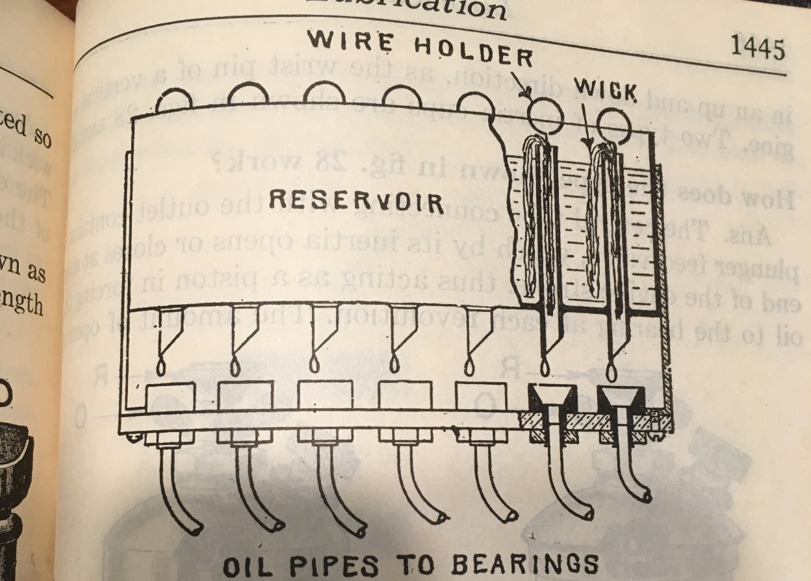
Multi-Point Oil Cup/Oil Feeder

Slide 12
Mechanical Lubricators
Common brands include Manzel, Acorn, etc
Positive displacement pump to force the oil into the bearing/steam line
They can and will gum up-take care to drain, flush with kerosene/diesel fuel, and refill every year.

Slide 13
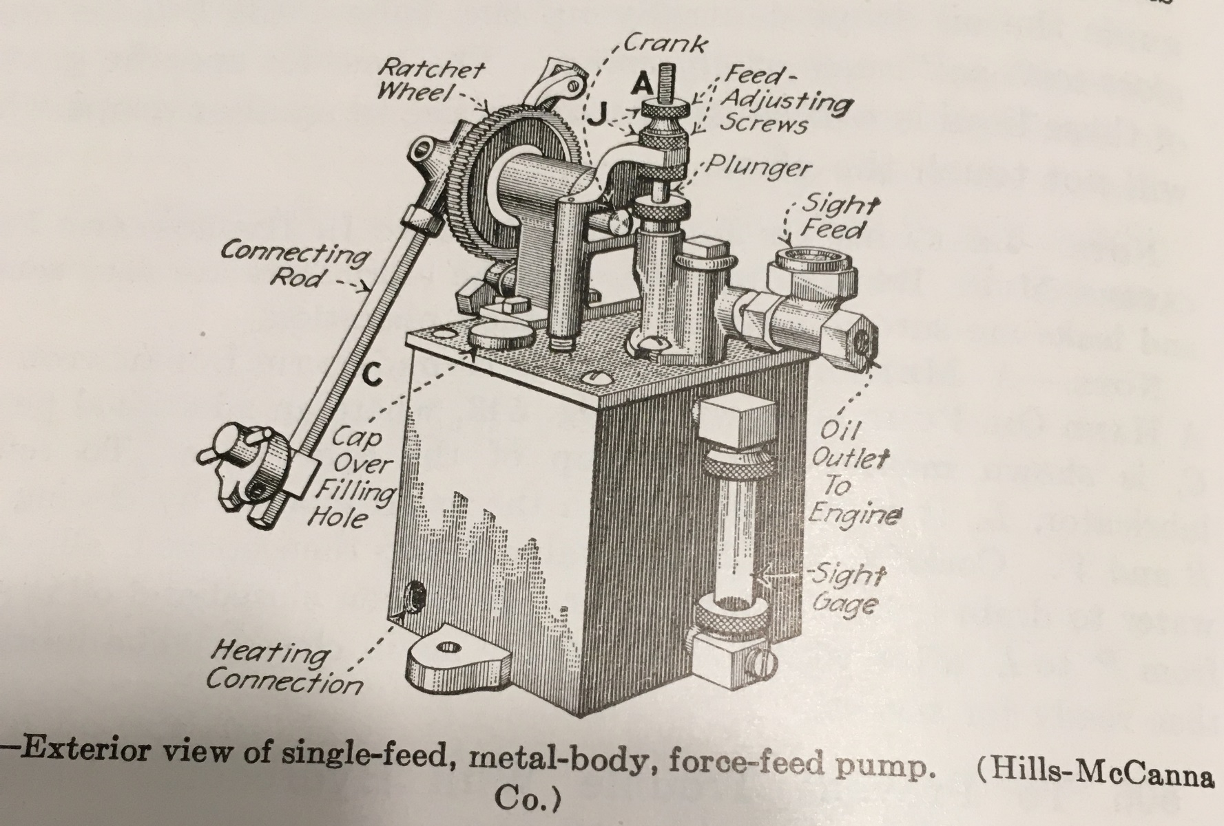
Mechanical Lubricator

Slide 14
Hand Pump oilers
Less common in traction engine service, but prevalent in stationary applications
Glass reservoir, hand pump to inject oil

Slide 15
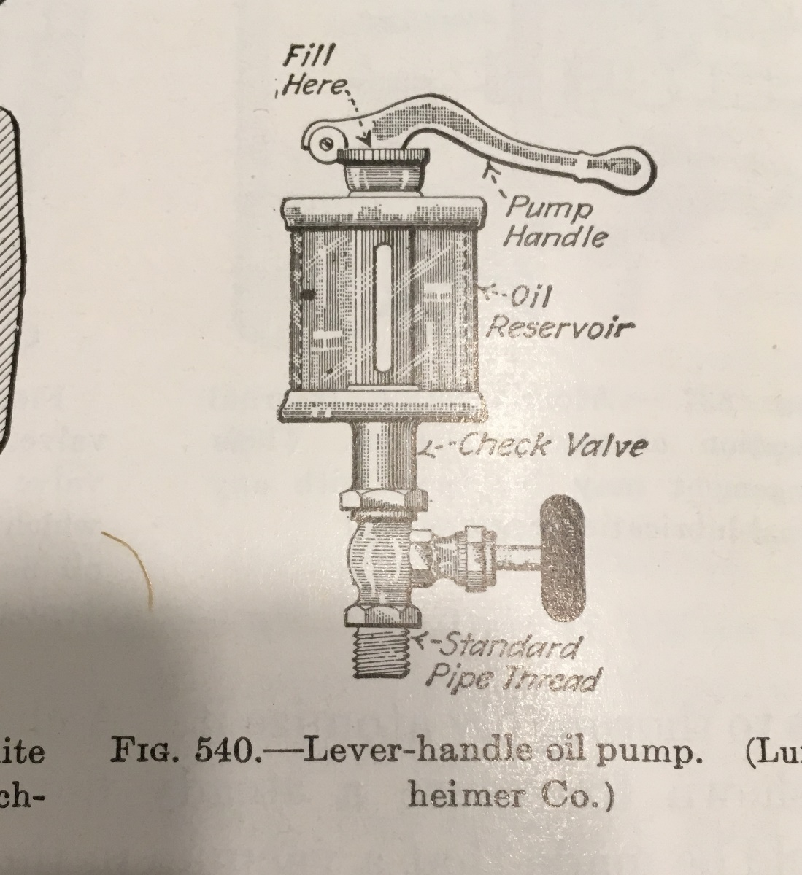
Hand Pump Oiler

Slide 16
Hydrostatic Lubricator
Uses condensed steam to force the oil into the steam
No moving parts
When oil is exhausted, must be drained of condensate, refilled with oil, and then re-started.
Require more operational attention than a mechanical lubricator

Slide 17
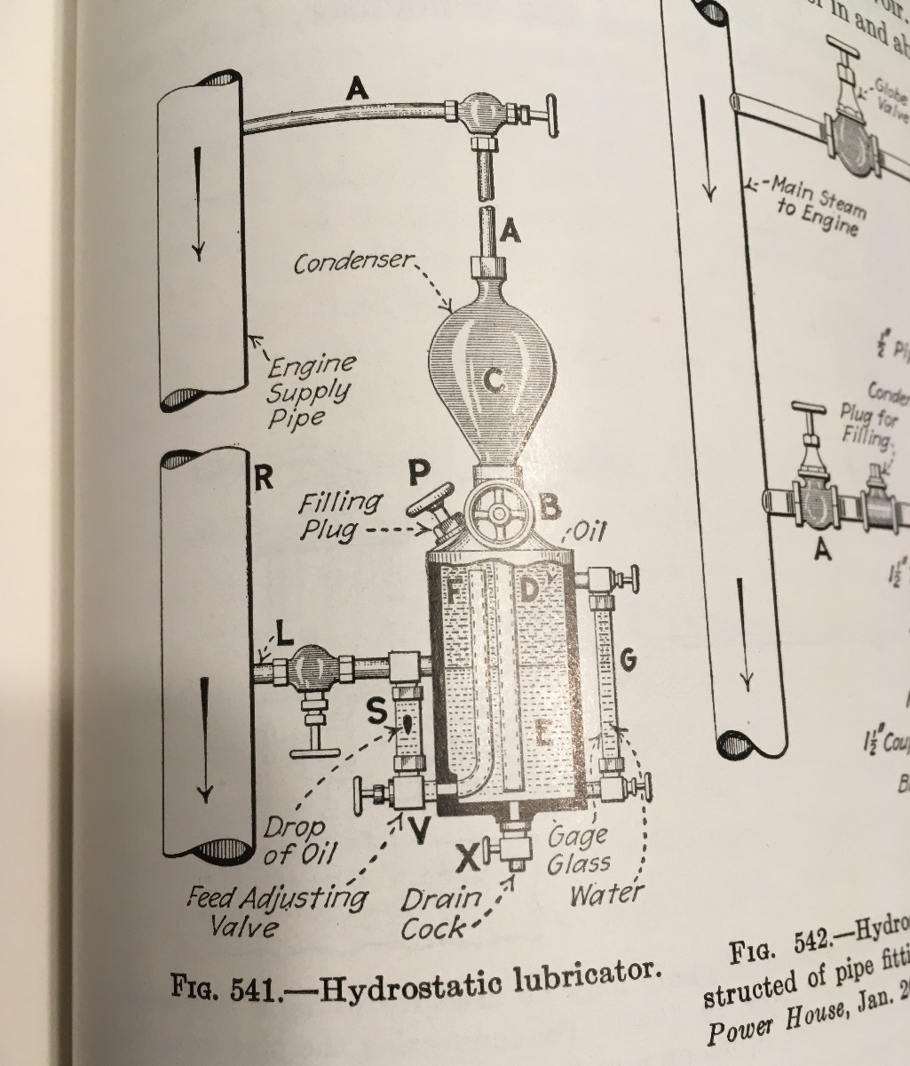
Hydrostatic Lubricator

Slide 18
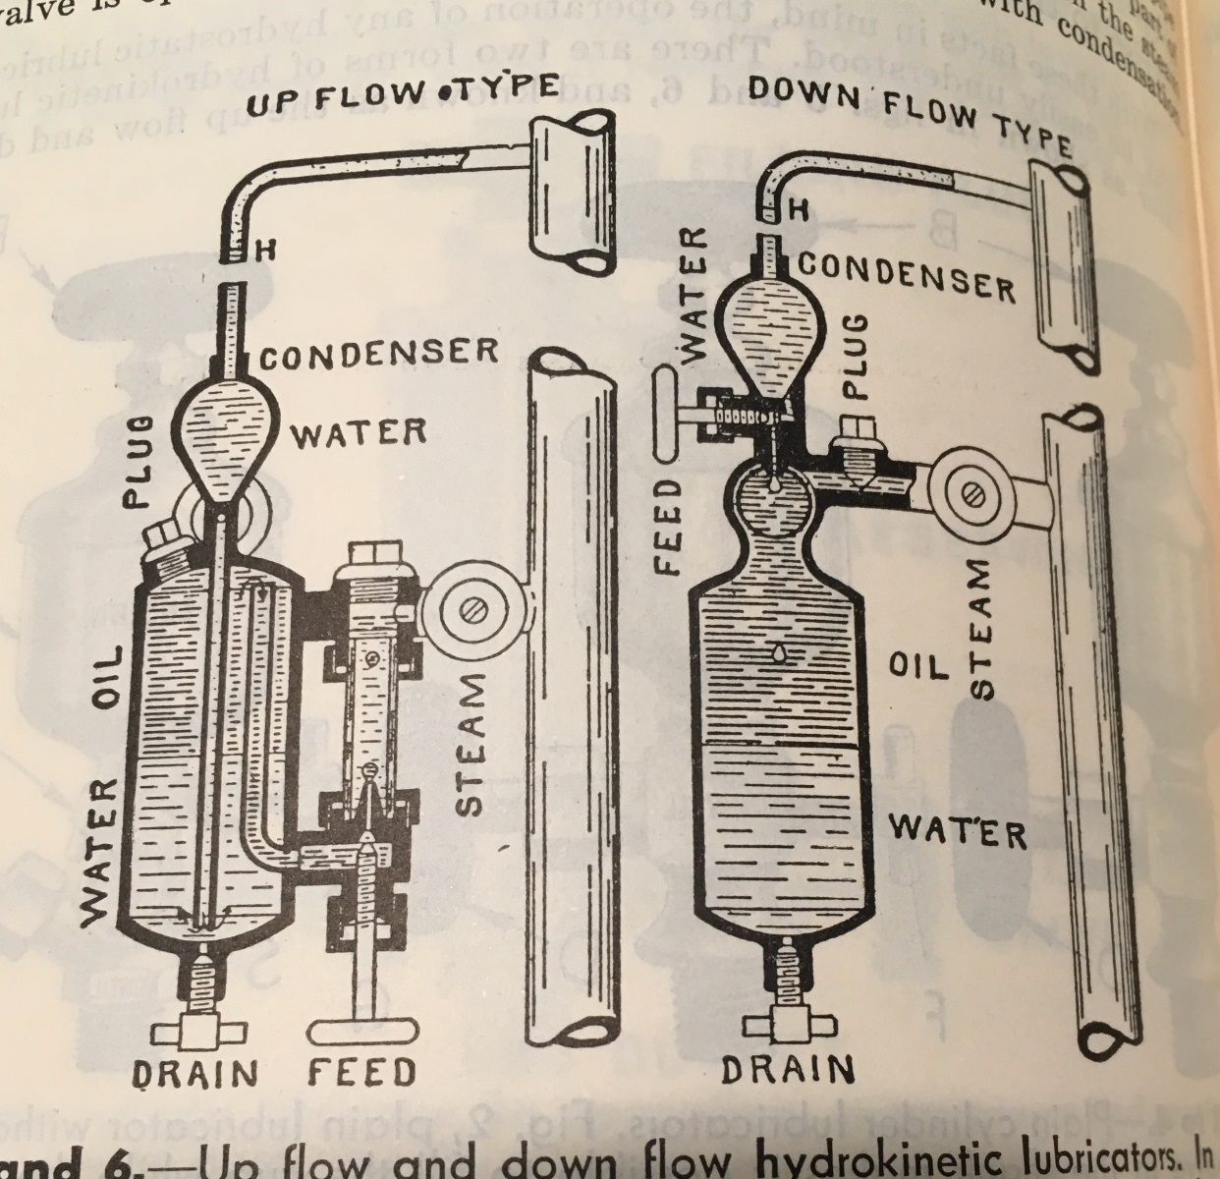
Hydrostatic Lubricator

Slide 19
Sight Glass/Drip oilers
Glass reservoir
Oil flow adjusted by knurled knob on top of lubricator
On/Off by flipping up the handle on top to turn on.

Slide 20
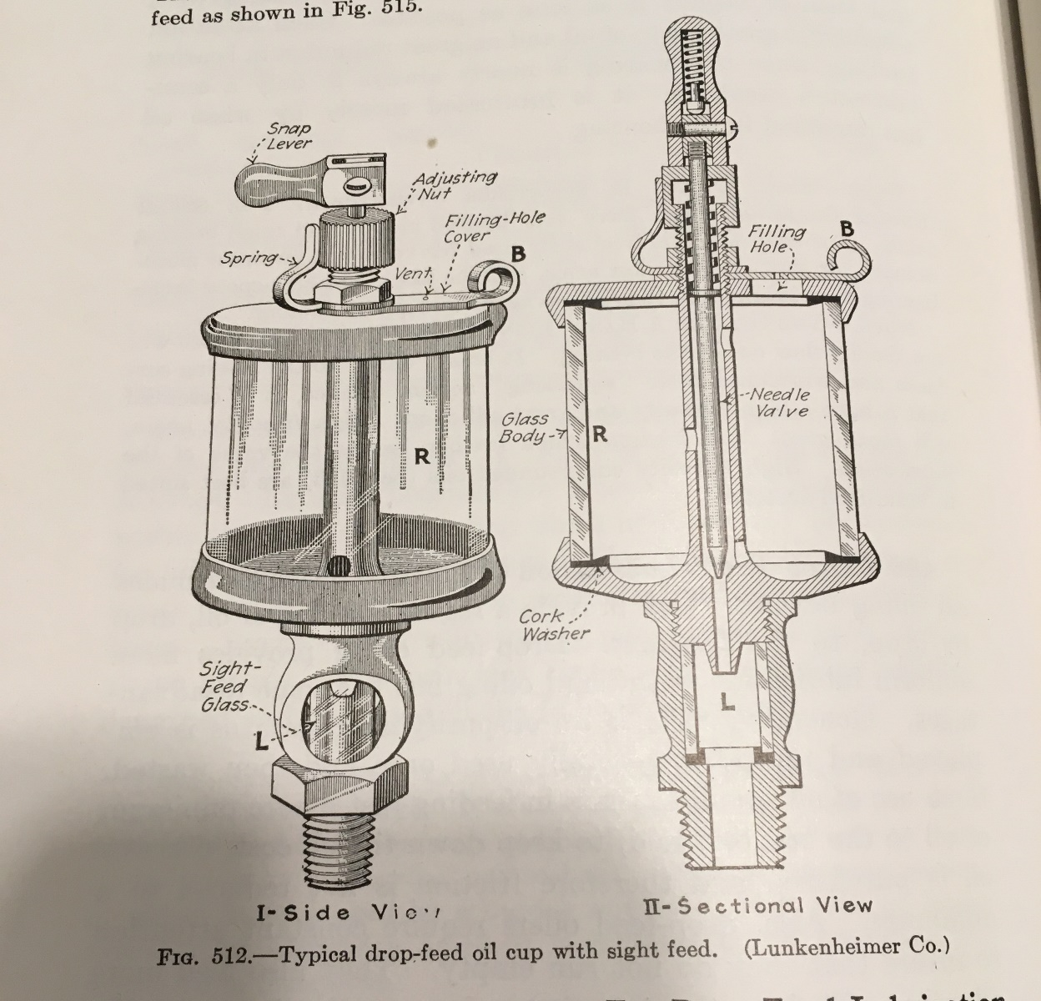
Lunkenheimer Drip Oiler

Slide 21
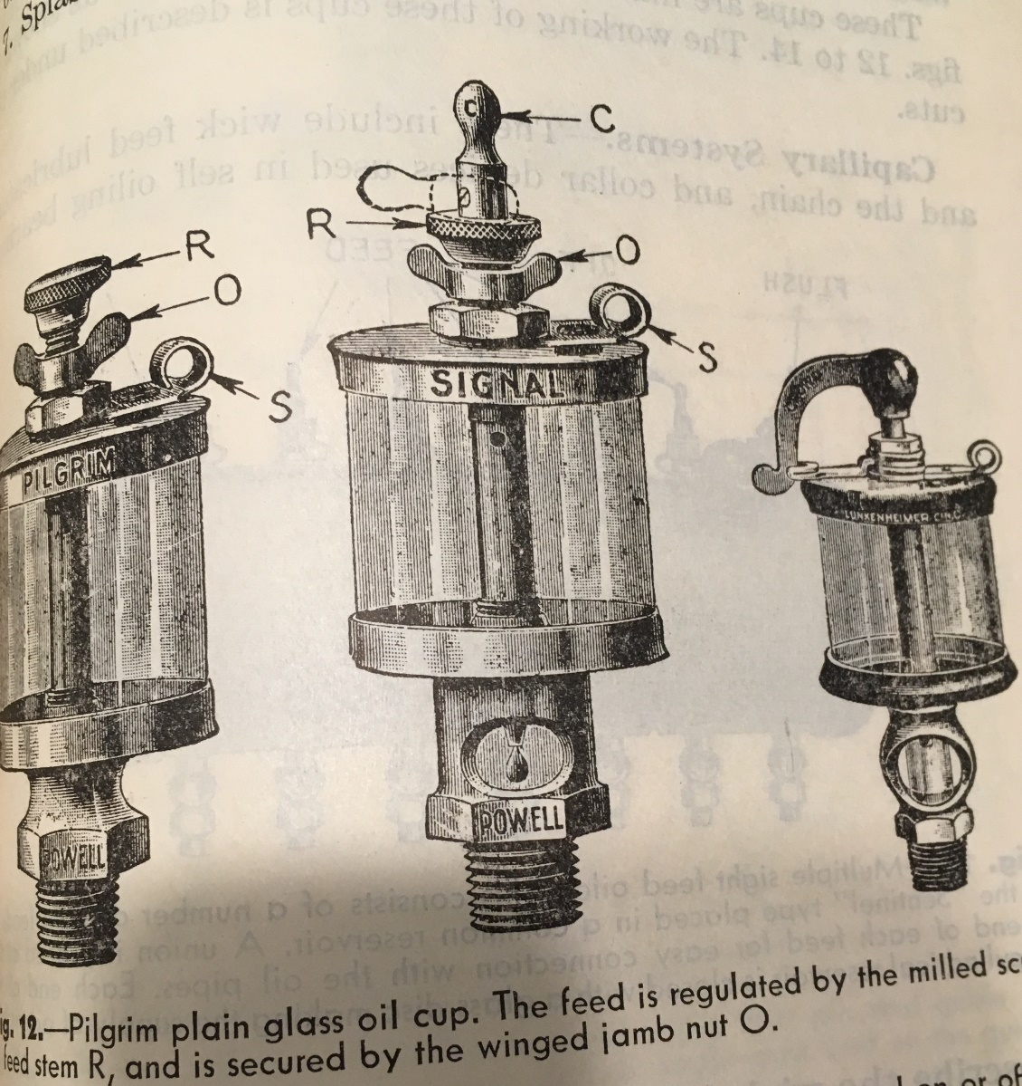
Other Drip Oilers

Slide 22
Screw/Spring/Auto Grease Cup
Spring loaded to ensure a steady supply of grease to the bearing
Feed rate adjusted by valve in bottom on grease cup (screwdriver adjust)
To fill, thread handle all the way IN (Threaded stem out) then unscrew top of grease cup, fill, and spin handle back down until spring engages

Slide 23
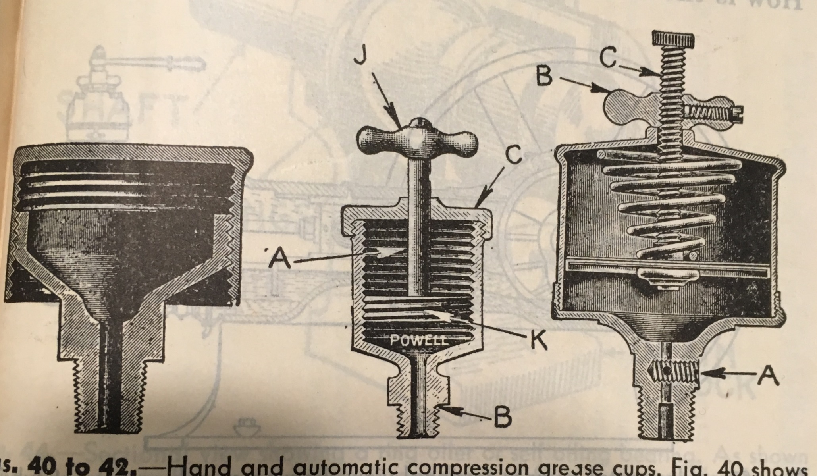
Grease Cups

Slide 24
Standard Grease Cup
Two part, lid is threaded to base.
To fill, unthread lid, fill interior with grease, thread back onto base.
Commonly found on wheel bearings, cannon bearing, other slow speed parts.

Slide 25
Grease Nipples
Also referred to as a Zerk or Alemite fitting
Positive coupling to a grease gun, a ball check within the fitting helps keep dirt/dist out of the bearing
Patented in 1929, so not very common on traction engines-but many engines have been retrofitted

Slide 26
Checking Bearings
“Constant Vigilance!” (to quote from Harry Potter...)
Use your senses-sight, smell, sound, touch
Infrared thermometer is a great investment
Remember-a bearing may heat from being too tight, too loose, or not enough lubrication
If unsure, stop the engine (when safe), and ensure that there is sufficient lubrication getting to the bearing

